Slide 1
NFPA 70E: Reducing and eliminating electrical hazards through electrical equipment design considerations
NAME:B.SRIKANTH
BRANCH:EEE
ROLL.NO:19951A0262
COURSE:Electrical Safety and Safety Management
SUBJECT CODE:AEEB41

Slide 2
Abstract:
This paper uses the National Fire Protection Association 70E Standard for Electrical Safety in the Workplace (NFPA 70E) as a guide for designing safer and smarter electrical equipment, in particular large horsepower motor starters under 600 volts. In the United States, the Occupational Safety and Health Act (OSHA) and NFPA 70E continuously raise the standard for electrical safety in the work place; as such, fundamentally changing how employers keep their employees safe and how employees interact with their electrical equipment. It is the employer's responsibility to abide by these safety standards; however, these standards should inspire better electrical designs that ease the employer's burden by reducing or eliminating employee exposure to electrical hazards - the latter should be the main goal of any electrical design.

Slide 3
We can accomplish much of this goal by providing employees with maintenance and troubleshooting tools on the outside of energized equipment by using Human Machine Interface touch screens that communicate with internal intelligent components, by isolating power and control components, using permanent electrical safety devices (PESDs) and electric door interlocks. This allows employees to troubleshoot, collect data, and configure motor starter components while it is energized and also eliminates and/or minimizes their exposure to electrical hazards.

Slide 4
INTRODUCTION: The human tragedy, its effects, and total costs of an electrical accident, especially arc flash hazards and electric shock, are well documented [1]. In the United States, OSHA and NFPA 70E are making great strides to improve electrical safety in the workplace and to promote awareness across all industries [2]. In spite of these efforts, electrical accidents continue to occur on a regular basis [3]. Furthermore, there are still companies that are not aware of or do not understand their legal OSHA obligations to provide employees with an electrically safe workplace.

Slide 5
Electrical OEMs follow a different set of standards when building their equipment; for example, NFPA 70 National Electric Code; Underwriter’s Laboratory 508A Standard for Safety: Industrial Control Panels; NFPA 79 Electrical Standard for Industrial Machinery; International Standards IEC 60204 Safety of Machinery; IEC 60364 Electrical Installations for Buildings are common standards. These codes are to protect us when equipment is energized and working under normal circumstances when components and conductors are behind enclosure doors. On the other hand, NFPA 70E is to protect us under abnormal circumstances when we need to work on de-energized as well as troubleshoot energized equipment [4].

Slide 6
ELECTRICAL DESIGN CHANGE CONSIDERATIONS
Much of our electrical equipment is static in nature in that once it is energized there is relatively nothing more to its operation than to conduct electricity, protect conductors and distribute power to other equipment. There is little operator interface with this equipment and maintenance is typically performed on an annual basis during planned shut downs;

Slide 7
Therefore, any maintenance is performed when the equipment is deenergized in an electrically safe work condition [5]. Any operator interface with energized distribution equipment is normally accomplished through a power metering device mounted through the equipment enclosure; therefore, energized components and conductors are safely behind enclosure doors and panels. On the other hand, the electrical equipment that we are concerned about, the controllers and motor starters that drive our processes can be very dynamic devices. Unlike panelboards that simply distribute power and provide overcurrent protection, controllers and motor starters need set-up on initial start up, adjustments after start-up and at times troubleshooting on faults or alarms. These activities could expose an operator to electrical hazards and put them at risk of an electrical injury if it is required to enter the equipment while energized [6].

Slide 8
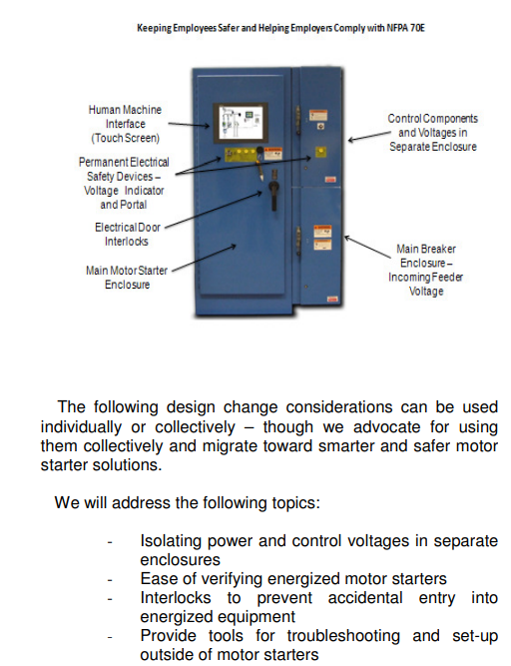

Slide 9
CONCLUSION: The NFPA 70E standard provides stringent requirements for employers that are meant to keep employees safe in their workplace from electrical hazards. Electrical shocks and arc flash hazards can severely injure, even kill, employees and costing companies millions of dollars. However, we can minimize these risks and prevent injuries by implementing design changes to electrical equipment that will keep employees safer and more productive. We should have a common goal when designing electrical equipment – to keep employees out of energized equipment while enabling them to excel at their job. Codes, standards and especially end-users are demanding and advocating for safe, robust and intelligent electrical equipment. The next step is to take the initiative to implement new technologies and strategies into our equipment designs that will make our industry safer and smarter.

Slide 10
THANK YOU…

